Slide 1
Operating system
Operating systems define how a computer stores files, switches between different applications, manages memory, keeps itself secure, and interacts with peripherals like printers and cameras. Different operating systems take different approaches to all of these, which is why you normally can't run a Windows program on a Macintosh computer and why permissions look different on an Android phone than on an iPhone.
Some operating systems are designed by groups of people around the world, like the open source, freely available operating system Linux, while others are commercial products made by one company, such as Microsoft's Windows and Apple's macOS.

Slide 2
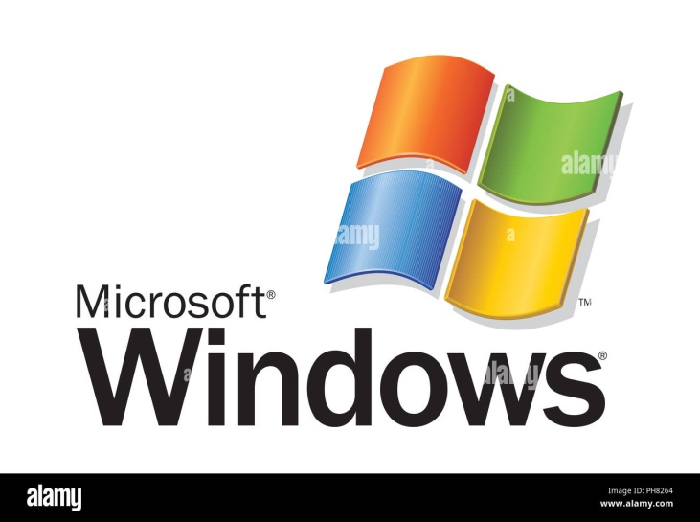
1.Microsoft Windows
Microsoft Windows has existed in one form or another since 1985, and it remains the most popular operating system for home and office computers. Its latest versions, including Windows 10, are also used on some tablets, and the OS is used on some web and number-crunching server computers as well. Computers from a wide variety of manufacturers can use Windows.

Slide 3
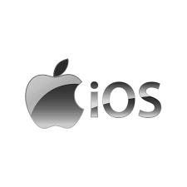
Apple's iOS is one of the most popular smartphone operating systems, second only to Android. It runs on Apple hardware, including iPhones, iPad tablets and iPod Touch media players. Signature features of iOS include the App Store where users buy apps and download free software, an emphasis on security including strong encryption to limit what unauthorized users can extract from the phone, and a simple, streamlined interface with minimal hardware buttons.
2. Apple iOS

Slide 4
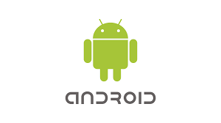
3. Google Android OS
Android is the most popular operating system in the world judging by the number of devices installed. Largely developed by Google, it's chiefly used on smartphones and tablets. Unlike iOS, it can be used on devices made by a variety of different manufacturers, and those makers can tweak parts of its interface to suit their own needs.
Users can download custom versions of the operating system because large portions of it are open source, meaning anyone can legally modify it and publish their own. However, most people prefer to stick with the version that comes on their devices.

Slide 5

4. Apple mac OS
Apple's macOS, successor to the popular OS X operating system, runs on Apple laptops and desktops. Based in part on the historic family of Unix operating systems dating back to research in the 1960s at AT&T's Bell Labs, macOS shares some features with other Unix-related operating systems including Linux. While the graphical interfaces are different, many of the underlying programming interfaces and command line features are the same.

Slide 6

5. Linux Operating System
Unlike many other operating systems, development on Linux isn't led by any one company. The operating system was created by Finnish programmer Linus Torvalds in 1991. Nowadays, programmers from all over the world collaborate on its open source code and submit tweaks to the central kernel software and other programs.

